Slide 1
eCommerce Market Analysis for a multi-category online store
- Gokul C

Slide 2
ABOUT THIS PROJECT
This capstone project is done as part of the course – “IITPKD's Professional Certificate Programme in Applied Data Science”. This project focuses on the eCommerce industry that is booming in this era. This project mainly aims at finding out the behaviour pattern of customers who brought a product from our online store. The dataset was provided by IIT Palakkad as part of the course.
All the data and notebook files used in this project can be accessed via my github: https://github.com/gokulkailas/Data-Science/tree/main/Capstone%20Project%20in%20eCommerce
I thank all my mentors and course providers for helping me complete this project.

Slide 3
TABLE OF CONTENTS
Abstract(4)
Introduction(5)
Context of the problem(6)
Purpose of the project(7)
Packages used(8)
Part 1:Exploratory Data Analysis(EDA)(9-11)
Part 2: Brand Analysis(12)
Part 2a: Brand Analysis(13-17)
Part 2b: Popular Products(18-21)
Part 2c: Conversion Rate(22-25)
Part 3: Recommendation System(26-32)
Part 4: Sales Forecasting(33-45)
Part 5: Final Thoughts(46-47)
Conclusion(48)

Slide 4
ABSTRACT
Electronic commerce is the process of doing business through computer networks. There are various types of e-commerce out of which the main 3 are:
B2B(Business-to-Business)
B2C(Business-to-Consumer)
C2C(Consumer-to-Consumer)
Out of this, the B2C(Business-to-Consumer) aspect of e-commerce is the most visible business use in the Internet. The primary goal of such a website is to sell goods and services online. This project takes data from such an online store and aims to predict what brands customers prefer and also to predict what the sales would be like for the next month.

Slide 5
INTRODUCTION
This project uses a dataset available from a multi-category online store to analyze and visualize data for behavior analysis of customers. The dataset is provided by IIT Palakkad as part of the course - IITPKD's Professional Certificate Programme in Applied Data Science.
The project aims to use this dataset for various purposes:
One of the aims is to find out what brands are favoured by customers when making a purchase online.
From the available data, the project also aims to predict what the sales are going to be for the next month from the online store.
The project also aims to include a recommendation system for customers so that they can find a good brand for the product they are searching for without much scavenging.

Slide 6
CONTEXT OF THE PROBLEM
With online sales gaining popularity in recent years, Internet has turned into a huge marketplace where people can purchase goods and services from the comfort of their homes. They only need a good internet connection and a phone/laptop to use the service. So it is crucial that companies take this opportunity to market and increase sales of their products through internet. Some of the problems that affect this services are:
Broad range of brands to choose a single product. Since there are many brands which provide the same product it is important for organizations looking to increase sales online to promote brands that are good and meet the demands of customers. If this is not the case, then the organization would fall behind in the competition. So a good recommendation system is important to keep the online market place lively.
It is also important for companies to understand the nature of their sales. They need to know the factors which keeps customers coming back to their website to make a purchase. This way organizations can predict what the sales for the next month or near future would be like. This also helps in ensuring stocks are available for products that are in high demand.
It also helps organizations to know which brands they are offering are of high value to customers. A high value brand means they are maintaining a standard that satisfies customer’s needs. It is very important to know which brands has acquired the trust of customers that are making a purchase from the online store.

Slide 7
PURPOSE OF THE PROJECT
This project aims to build a machine learning model that can do the following:
Which brands are favored the most by customers out of available brands.
A recommendation system where customers can find the product they are looking for in the online store without much scavenging.
Predict the sales for the next month with data available from previous month and make decisions on what to focus on.

Slide 8
PACKAGES USED
We will be using quite a few packages to help with this project namely:
Pandas
Numpy
Matplotlib
Seaborn
Statsmodels

Slide 9
Part 1:Exploratory Data Analysis(EDA)
The first step of any problem related to data is knowing what kind of data we have. For this project the dataset contains information about products from a multi-category online store. The columns(features) available to us are:
event_time : Time at which the event took place
event_type : Event type may be 'view', 'cart', 'remove_from_cart', 'purchase'
product_id : Unique identification of the product
category_id : Unique identification of the product category. Each product category contains several products
category_code : Name (if present) of the product category
Brand : Name of the brand
Price : Price of the product
user_id : Permanent user id
user_session : Identification for the user's session. Remains same for each user's session. It changes everytime the user returns back the website after a long pause
We can see that there are 9 columns in this dataset. Also data is available for 3 months – October, November, December in the year 2019.

Slide 10

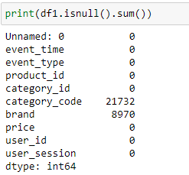
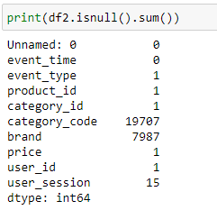
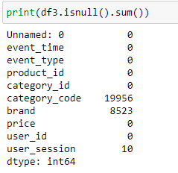
Part 1:Exploratory Data Analysis(EDA)
So let’s do the preliminary steps in data analysis. First let us check if there are any nulls in any of the columns in the dataset. If there are null values we have to remove them or replace them with some value so that they don’t cause issues when building our model. For this we make use of the available functions in python. Below are the results of our analysis:

Slide 11
Part 1:Exploratory Data Analysis(EDA)
Observations:
We can see that the above dataset does contain null values and most of them are in columns : brand and category_code.
Going forward when doing any kind of analysis we must remove these null values or they will mess with our results.
Also going through the dataset we checked for duplicate entries and found out that the dataset do not contain any duplicated entries.
With this we can conclude the preprocessing phase of the data and go to core project part starting with Brand Analysis.

Slide 12
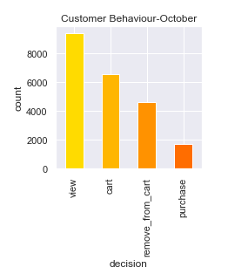
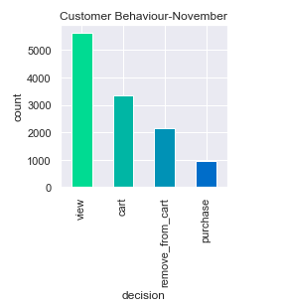
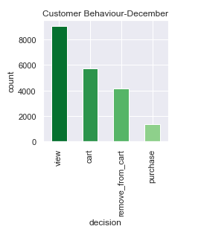
Part 2: Brand Analysis
In this part, we can do some analysis of our data to find out a couple of things:
Brand Analysis: Here we can see which brands were popular among customers for each month.
Popular Products: We can also see which product was popular among customers
Conversion Rate: We will also see just how many customers purchased something which they added into cart.
Before we begin, let us observe how the customer behavior was like for the 3 months – October, November and December below:

Slide 13
Part 2a: Brand Analysis
It is evident from the graphs above that most of the customers were just browsing without having the idea of purchasing some products from the store. This is because the number of purchases in all 3 months were below the number of viewing and carting of products. Also quite a few number of people removed their added products from cart, this maybe because they had a change of mind mid purchase or they might have run into some transaction related problems.
Also the number of purchases were maximum for the month of October with 1722 products purchases across various customers followed by November with 1401 purchases and lastly by December with 1346 purchases.
Now for our brand analysis we will be looking at the number of sales each month had and then figuring out which brand had the most sales in all 3 months. We modify our dataframe to make this task easier. The steps are:
First we create a data-frame where all the event_type are just purchases.
Then we create another data-frame where we take all non-null values of brand from the dataframe above.
Then we use the ‘group_by’ function in python to create yet another dataframe where all the products in a brand are grouped together under that brand and arranged in ascending order.

Slide 14
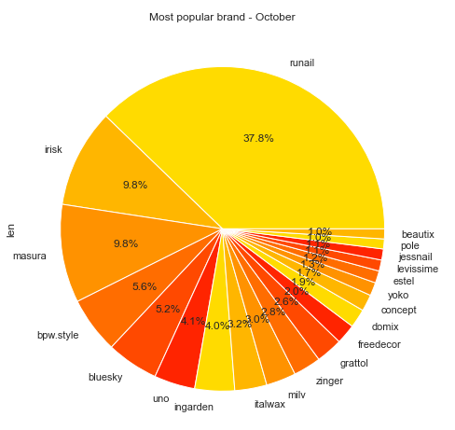
Part 2a: Brand Analysis
Now let us take a look at results of the data-frame created above for the month of October: Here we use a pie chart for visualization.
The pie chart shows the top 20 popular brands among customers who shopped online for the month of October.
We can see that the brand ‘runail’ was the most popular brand with 37.8% of total sales and far ahead of other brands.
The top brand sold more than double the products of the second brand.

Slide 15
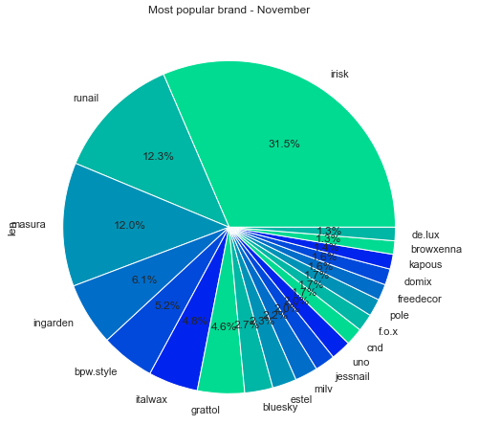
Part 2a: Brand Analysis
Next we can do the same analysis for the month of November. We are using the pie chart for visualization.
This pie chart shows the sales for month of November. Compared to the previous month the total sales are a bit less.
Here the popular brand changed to irisk with a total of 31.5% of total sales trailed by ‘runail’ with 12.3% of sales. So clearly the customers who purchased had a change of mind regarding their favorite brand to purchase.
Here also the top brand sold more than double the products when compared to the second.

Slide 16
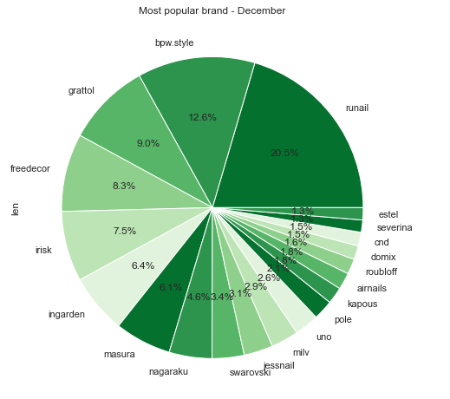
Part 2a: Brand Analysis
Now let’s look at the same pie chart visualization for the month of December.
Here we can see that the brand with the most sales changed from ‘irisk’ to ‘runail’ again. But the distribution of sales across brands are now showing a change.
Here the top brand ’runail’ only has 20.5% of total sales whereas in the previous months the share of the top brand was more than 30%. Also ‘runail’ was the most preferred brand in the month of October as well, so whatever strategy they did to improve sales over the month of November worked.
We can see that the sales market got a lot more competitive as the brands which had low
sales in previous month are now gaining more sales.

Slide 17
Part 2a: Brand Analysis
A couple of observations:
Month of October saw the most sales and brand ’runail’ sold the most products during this month. They also had a large percentage of total sales for the month sitting at 37.8%.
Month of November saw a change in the brand which had the most sales with brand ’irisk’ obtaining a large percentage of total sales sitting at 31.5%. But the total sales volume had gone down in November.
December month was interesting, even though the sales numbers were a bit less than the previous two months, December saw the most competition between various brands. Although the distribution of sales was not equal, most of the brands which underperformed in the previous two months had made a jump in the total products sold. Also we saw brand ‘runail’ rise to the top once more with 20.5% of total sales.
Now that we know what the popular brands are for all 3 months, let’s delve a bit deeper and find out what products were most customers looking for. In this section, we will still be looking at the sales of products in each category. So if a product is just viewed or added to cart we will not be considering them as a sale. Only products which are purchased are considered in sales.

Slide 18
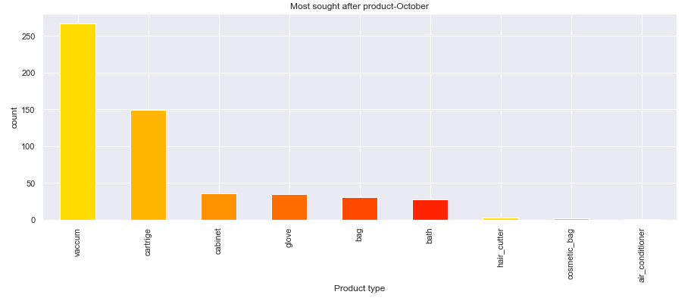
Part 2b: Popular Products
The above bar chart show the products which was sold the most in the month of October.
We can see that vaccum had the most sales in this month followed by cartrige. Most other products saw low number of sales.
Maybe there is a new type of vaccum in the market and that is why there is a demand for vaccum. Printer cartriges need to replaced every now and then so they also saw a decent amount of sales.
Air conditioner products did the worst sales in the month of October. Maybe the climate was nice that people did not find any need to buy more AC’s.

Slide 19
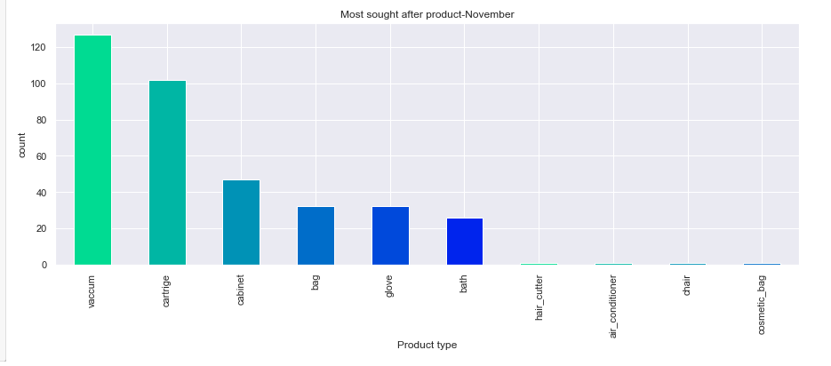
Part 2b: Popular Products
The above bar chart shows which were the popular products in November month.
Here also the most bought product is vaccum.
We see that in this month there was a new category of product available in the market-’chair’. But it did not do so well.
Overall sales were less this month compared to previous month.
Cosmetic_bad category was the least popular item for sale this month

Slide 20
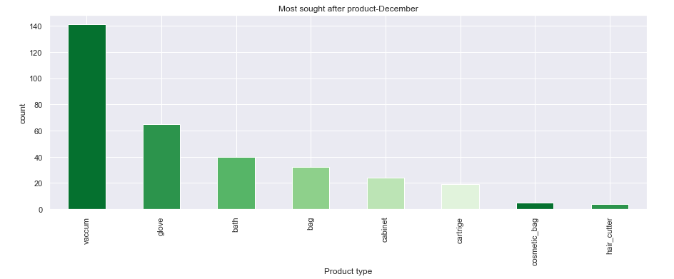
Part 2b: Popular Products
The above bar chart shows the sales for different category of products for the month of December.
Here too vaccum remains the most sought after product.
Some product categories were taken off the store like ‘chair’, ‘Air conditioners’ etc. maybe due to their lack of demand.
The overall sales were a bit lower than previous month but the top product made more sales than the previous month. This maybe because some product categories were taken off sales.

Slide 21
Part 2b: Popular Products
Some insights into the popularity of products:
Most sold item was vaccum for all 3 months.
Some new categories of products were introduced after the sales of the first month but it did not do so well.
Since there was a lack of demand for newly added products and even for existing products, the last month of the sales saw a drop in total sales as the low performing categories were taken off sale.
Now that we have some insights on the popular categories that customers were after, let us look at the conversion rate. Here we are looking at the conversion rate of customers over the period of one month and repeating it for the next two months. We might have some interesting numbers and gain insight into the behavior of customers shopping online and what they are looking for when they shop online.

Slide 22
Part 2c: Conversion Rate
Here we look at the number of people who viewed or carted or purchased an item from our store.
First we will look for October month. The graph is as shown below:
Here we see that the count of people who viewed is 9371, those who carted are 6565 and those who purchased a product are 1722.
Rate of conversion between view and purchase = 18.37%
Rate of conversion between view and add_to_cart = 70.05%
Rate of conversion between add_to_cart and purchase = 26.2%
So people have a higher chance of buying something if they added that item to their cart than just directly buying them.
Also a large number of people add the item to their cart and maybe plan to buy it at a later stage.
People who removed items from their cart are not taken into consideration here as we just wanna know about the behavior of people who convert their browsing of products into purchases.

Slide 23
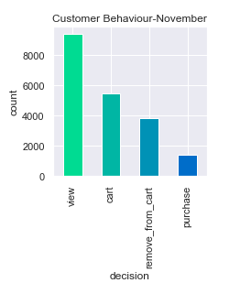
Part 2c: Conversion Rate
Now let’s look at the same type of graph for November month.
Here the total customer interactions are a bit less when compared to previous month.
View count is 9380, cart count is 5485, purchase count is 1401.
Rate of conversion between view and purchase = 14.93%
Rate of conversion between view and add_to_cart = 58.47%
Rate of conversion between add_to_cart and purchase = 25.54%
Compared to previous month we can see some changes in our percentages.
Rate of conversion for all 3 factors dropped this month.
There was a drop of almost 12% in people viewing and adding an item to their cart. This was the way most people who shopped online bought their item.
There was a small drop in people directly buying an item after viewing them.
Also there is a small drop in people purchasing product after
adding it to their cart.

Slide 24
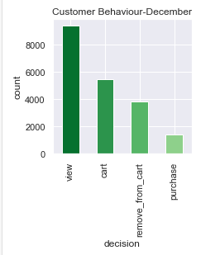
Part 2c: Conversion Rate
Let’s now look at the same graph of December month.
Here also there is a change in the number of people who viewed, carted and purchased a product.
View count is 9050,cart count is 5719, purchase count is 1346
Rate of conversion between view and purchase = 14.87%
Rate of conversion between view and add_to_cart = 63.19%
Rate of conversion between add_to_cart and purchase = 23.53%
Compared to last month there is not much change in the percentage of people directly buying an item after viewing it.
The number of people carting an item has slightly increased this month when compared to previous month.
But people who buys an item after adding it to cart has decreased by a small amount.

Slide 25
Part 2c: Conversion Rate
We can find the following observations from the conversion rate:
A lot of people like to cart the products they see on the online store. And a good percentage of people buys the item they cart.
The percentage of people who buys an item directly after viewing the item is less when compared to buying an item added in cart. So most people are looking for better offers for the products in their cart before buying.
People who buy directly without carting maybe looking to get the items to them as soon as possible.
Through the 3 months of data the percentage of people who added an item to their cart was more than the percentage of people who bought items.
Also there was a large number of items which were removed from cart.
So perhaps some customers are finding some products dull after carting them or some may have run into some network errors or transaction problems. Since data is not available for these scenarios we cannot tell for certain.
Now that we have covered some basic customer behaviour on our online store, we can move on to building a recommendation system for our store.

Slide 26

Part 3: Recommendation System

Slide 27
Part 3: Recommendation System
A product recommendation is basically a filtering system that seeks to predict and show the items that a user would like to purchase. It may not be entirely accurate, but if it shows you what you like then it is doing its job right.
Recommender systems have become increasingly popular in recent years, mostly used in the digital domain, majority of today’s E-Commerce sites like eBay, Amazon, Alibaba etc make use of their proprietary recommendation algorithms in order to better serve the customers with the products they are bound to like. And if set up and configured properly, it can significantly boost revenues, CTRs, conversions, and other important metrics. Moreover, they can have positive effects on the user experience as well, which translates into metrics that are harder to measure but are nonetheless of much importance to online businesses, such as customer satisfaction and retention.

Slide 28
Part 3: Recommendation System
There are different types of recommendation systems. Some of them are:
Collaborative Filtering
Content-based Filtering
Hybrid Recommendation System.
For the purpose of this Project I am using type of content-based filtering system. These filtering methods are based on the description of an item and a profile of the user’s preferred choices. In a content-based recommendation system, keywords are used to describe the items; besides, a user profile is built to state the type of item this user likes. This is because the dataset used for this project does not have access to reviews/rating left by the user. But the dataset has access to the sales of each unique product over the course of 3 months.
The recommendation system, I have designed below is based on the journey of a new customer from the time he/she lands on the business’s website for the first time. So our model for recommendation would be based on product popularity.

Slide 29
Part 3: Recommendation System
We have access to a dataset that contains information about the products and their events for a duration of 3 months. We will be taking the unique product_id’s of the products sold in our dataset and comparing their sales to know the popularity of products that are sold and then we can recommend the product with the most popularity to the new customers who are landing on our online store for the first time. Popularity based recommendation systems are a great strategy to target the new customers with the most popular products sold on a business's website and is very useful to cold start a recommendation engine.
So before we start with the system we merge the 3 datasets of 3 months into a single dataset to get the overall most popular product. With the help of concat function in pandas library this task is made easy. Then we filter our dataset and keep all the records of the products that are sold. We will be looking at two types – First which product the customers most interacted with and Second which product was most bought by the customers.

Slide 30
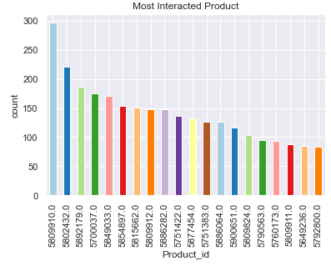
Part 3: Recommendation System
So after preprocessing of the data and removing null values we get the following result for our first kind of analysis – which product most customers interacted with.
Here we see that the product with id – 5809910.0 was the product which was the most popular amongst customers. This had a total of 297 interactions, but this is considering all who viewed, carted, removed_from_cart and purchased this product.
Since this is not a good indicator for recommendation we will move on to the next one.

Slide 31
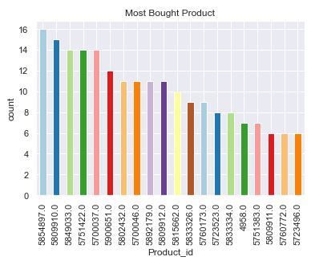
Part 3: Recommendation System
This graph shows only the products that were brought by the customers.
This graph is a more accurate representation of products that were most popular with the customers who purchased from our online store.
The product with id – 5854897.0 is the product with the most sales followed by 580991.0. This is in stark contrast to what we saw in the previous graph. The product with id -580991.0 was the most interacted product but it is the second most bought product.
For the purpose of this project we are only considering the top 20 popular products based on their sale. The total sale for all 3 months from our online store is 4469. Including everything in this graph would be clumsy.

Slide 32
Part 3: Recommendation System
Points to consider:
From our analysis we saw that the product with id - 5854897.0 had the most sales and were most popular among the customer base. Also all the top 20 products had some good sale numbers considering that there are more than 3210 unique products that are listed on our online store.
So for recommendation, on our front page/app of the store we can give enticing offers and good discounts on popular products that we already have data of and then advertise them to our target customers.
Moving forward, we should encourage those who purchase from our online store to leave a review/rating of the product we purchased so that we can build a better recommendation system in the future.
This concludes our recommendation system part. In the next part we will be proceeding with sales forecasting using ARIMA model.

Slide 33
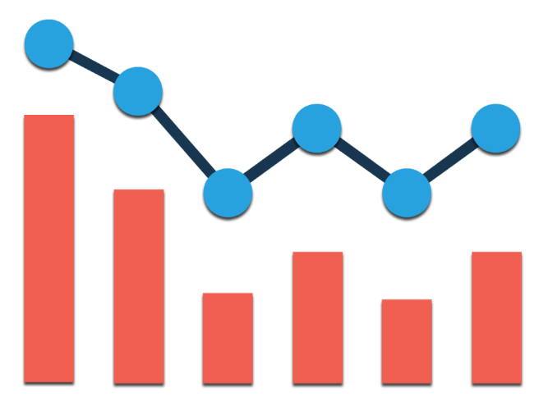
Part 4: Sales Forecasting

Slide 34
Part 4: Sales Forecasting
Sales forecasting is the process of estimating future revenue by predicting the amount of product or services a sales unit (which can be an individual salesperson, a sales team, or a company) will sell in the next week, month, quarter, or year.
Forecasts are about the future. It’s hard to overstate how important it is for a company to produce an accurate sales forecast. Privately held companies gain confidence in their business when leaders can trust forecasts. For publicly traded companies, accurate forecasts confer credibility in the market.
For the purpose of our project we will be using the ARIMA model. ARIMA (Auto-Regressive Integrated Moving Average) is a statistical modeling technique for time series analysis and forecasting. Compared to machine learning, ARIMA is a classical modeling approach that is particularly powerful when the time series being analyzed follows a clear pattern. Due to its effectiveness, ARIMA(Autoregressive Integrated Moving Averages) is frequently used in various economic and scientific applications. Examples are forecasting weather data, predicting order quantities, and sales forecasting.

Slide 35
Part 4: Sales Forecasting
For the purpose of forecasting sales, we first merge our three datasets that we have into one. We use the concat method in pandas for this purpose. After this we will take just two features of our dataset namely ‘event_time’ and ’event_type’.
We will be doing some preprocessing of the data to remove missing/null values. Since there are no duplicate entries we can move forward with creating our model.
Now to plot a time series we need two things – time and sales. Since our dataset already has time, we just need to format our time feature in such a way that it shows the total sales in each day and since we have the data available for 3 months, we can see how our sales looked like for the entirety of these 3 months and build a model to forecast our future sales.
We make use of some good functions available in pandas and python as a whole to format our dataset in the required manner. This is explained in the next section.

Slide 36
Part 4: Sales Forecasting
The method to create a timeseries dataframe for the purpose of this project are as follows:
First we create a dataframe with just two features:’event_time’ and ‘event_type’.
Then we convert the event_time feature into a datetime datatype using method available in pandas library.
Then we extract just the date part(yyyy-mm-dd) from our event_time feature and create a new feature to store this date. Aftwerwards, we remove the event_time feature as it is no longer needed.
Then we filter the event_type field and take only those event types that are purchases as the rest cannot be considered as fields. We make use of readily available functions of dataframe in python for this purpose.
Next with the help of a dictionary we replace the purchase word in event_type feature into 1’s.
After all this process we make use of the extremely useful groupby function in python to create our timeseries dataframe. By doing this we can get a cumulative number of sales that occurred in each day and then we can plot a timeseries graph. This is shown in the next section.

Slide 37
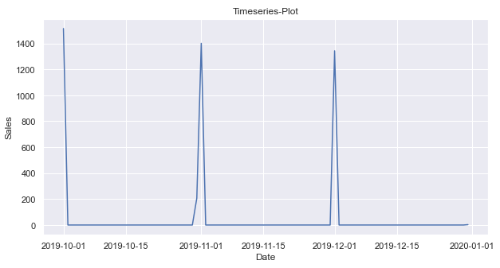
Part 4: Sales Forecasting
Here we have our time series plot and we can clearly see that most of the sales in each month happened in first and last days of each month. Also most intermediate days in each month had 0 sales. So there is quite a behavior seen here. Almost all days of the month had 0 sales and the beginning and end of each month saw the most sales.
Before we go about building our ARIMA model for forecasting there are certain steps to be done. This is explained in the next section.

Slide 38
Part 4: Sales Forecasting
Before we delve deeper, we have to understand that for the 3 months data that we have sales have happened for only a few days. This is evident from the above graph. Sales happened at the starting and ending point of each month. So we are lacking data. So the ARIMA model that we are going to built will be somewhat lacking but we can still perform a good analysis on sales.
First step will be to check for stationarity, trend and seasonality in our data.
Stationarity : If the statistical properties like mean and variance of a timeseries data do not vary with time, we say the timeseries is stationary.
Trend: A trend is a long term upward or downward pattern in our timeseries data.
Seasonality: This is a recurring movement that is present in the time series variable.
So for forecasting a time series data we need the data to be stationary with the trend and seasonality removed. We will be looking at these properties of our dataset in the next section.

Slide 39
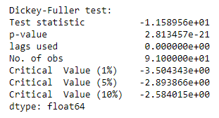
Part 4: Sales Forecasting
Within python there is a package called statsmodels which hosts a library called adfuller. This is a library to perform a “Dickey-Fuller test”. This test uses the concept of hypothesis testing to check for unit root in our time series. In this test we have a value called p-value, if the number corresponding to the p-value is less than 0.05 in this test, then we can say that the time series data is stationary.
For our data the results of this test analysis is as below.
In this if we see the p-value, its value is less than 0.05. So we reject the null hypothesis which says our timeseries data is non-stationary.
So we can say that the statistical properties like mean and variance of our data do not change with time. Hence our data is stationary. This concludes our first phase of analysis.

Slide 40
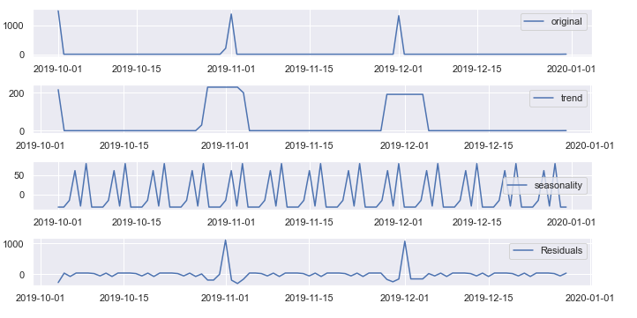
Part 4: Sales Forecasting
Next we check for trend and seasonality in our time series data. For this purpose also we use the statsmodels package. In this package we can use a library called seasonal_decompose. Below are the results of our analysis.
We can see that there is no upwards or downwards trend in our data.
We can see that there is some seasonality in our dataset as most products are purchased at certain fixed intervals. So before building our ARIMA model we need to remove this seasonality.

Slide 41
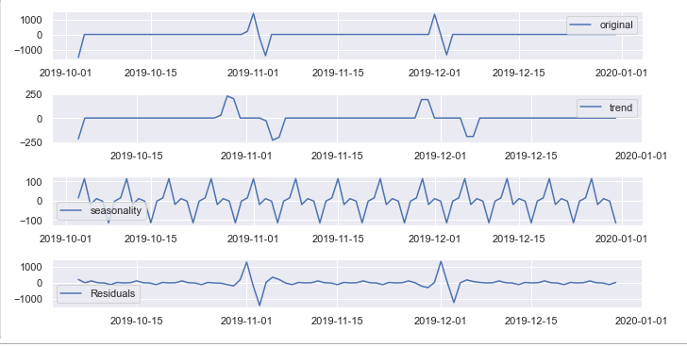
Part 4: Sales Forecasting
A simple way to remove seasonality is by differencing. So in our dataset we take the second order difference to remove seasonality. Differencing is the process of computing the differences between consecutive observations. Since first order differencing did not remove seasonality in our time series data we did the process two times to reduce seasonality as low as possible. The resulting decomposition of our time series data is as follows:
Here we observe that the seasonality is reduced and now we are ready to proceed with building our model.

Slide 42
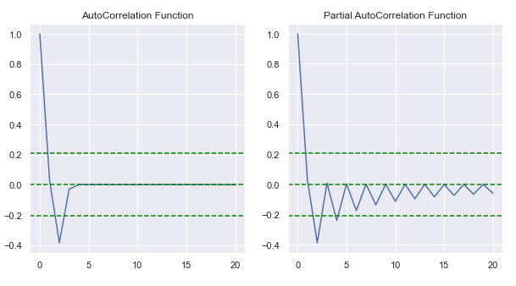
Part 4: Sales Forecasting
When we are building our ARIMA model, we need 3 parameters - Autoregression, Difference, Moving Average Parameters. Since we took second order difference our Difference parameter is 2. Autoregression Parameter is obtained from Partial AutoCorrelation Function graph and Moving Average Parameter is obtained from AutoCorrelation function graph. These are listed below:
From the graph our AutoRegression parameter is 1 and our MovingAverage parameter is 0.
Now that we have all this information we can go ahead with buiding our model.

Slide 43
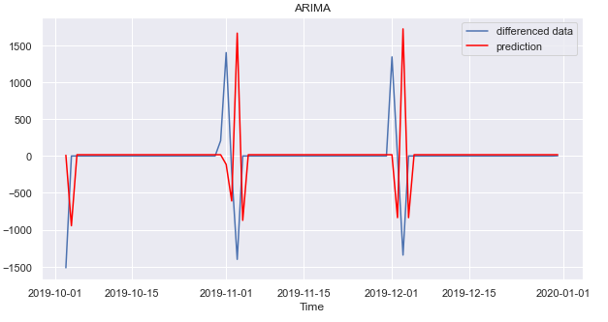
Part 4: Sales Forecasting
We build an ARIMA model with the parameters which we defined before. The below plot shows how our model fits on the differenced data:
Now we can use the model trained on this dataset to make predictions for the sales that will happen on the following months.

Slide 44
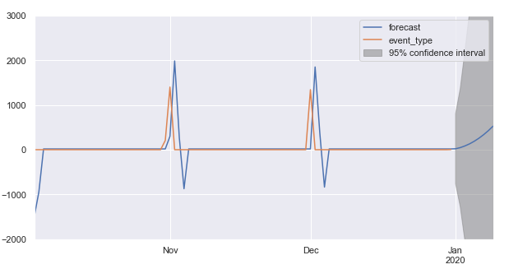
Part 4: Sales Forecasting
The above graph shows our model predictions. The grayed out area is a confidence interval with 95% confidence. This means that we can say with a 95% confidence that our sales in the coming months will lie between this interval.

Slide 45
Part 4: Sales Forecasting
We can see that the sales forecast covers a wide area. Part of the reason for this is inadequacy of data. As we have already seen, our dataset is sparse in sales information. So our model faced difficulty in learning the patterns. This could have been prevented by getting even more data on sales where sales were calculated as 0, but for this dataset that information is not available. Although there are datasets out there with the same features which have even more data, the information in those datasets is different from what we have here. So this is the best model I could come up with for the data provided.
This concludes our sales forecasting journey.
Now in the next section I want to explain just how this entire project can be made better in the future with the availability of more data.

Slide 46
Part 5: Final Thoughts
In this project we saw how data from an eCommerce website can be utilized for various purposes. The ask of the project was to determine which brands were favored by customers, and to predict sales for the coming months along with building a recommendation model. Below are my final thoughts as to what has been done and what could have been done better. This also opens a door for future developments of this project:
During brand Analysis we saw just what brands had the most sale and also which products our customers were looking for the most. We also saw the conversion rate of customers in different months and came to various conclusions. Going forward this can be made even better by doing a user’s journey through our website so we can lock in on what makes the customers actually buy our product.
Then we build a recommendation engine. This was a basic recommendation system based on the products that were most popular amongst customers. If we had access to product ratings/reviews, we would have been able to build an even more better engine. This opens up scope for this project in the future if we can get access to these kinds of data.

Slide 47
Part 5: Final Thoughts
Finally we made sale prediction using time series analysis. We made use of the powerful statistical tool ARIMA(Autoregressive Integrated Moving Averages). Through this method we were able to forecast sales for the month of January. But the forecast was wide and not accurate enough due to the unavailability of data for a lot of days. If we had access to sales data for 1 or 2 years or even more than 6 months, our analysis of sales would have gone far better.
This concludes my final thoughts on this project. The results of my analysis can be used to make better business decisions going forward. We know which brands are popular, we know which products customers are mostly looking for and we can even recommend our top products to new customers as well. For the organization, Sales forecasting is important and we know the sales would happen in coming months as well, but we need access to more data to conveniently build a model that can make even more better predictions.

Slide 48
Conclusion
This concludes this project. We have scope for improvement in the future.
I want to take this opportunity to thank all the faculty members, mentors and all who worked behind the scenes of Eruditus and IIT Palakkad for helping me complete this journey in Data science and in guiding me to complete this project. Thank You.

